Slide 1

Predictive Maintenance for an Industrial Application
By: Mohan Kumar Sah

Slide 2
Contents
Introduction
Company
Datasets and Algorithms
Work
Traffic Sign Recognition
Problem Statement
Proposed Solution
Results
Predictive Maintenance
Problem Statement
Proposed Solution
Results
Additional Work “Voice Chatbot”
Logic used to build the Voice Chatbot
Implementation and Results
Conclusion

Slide 3
Introduction
I carried out my internship as Machine Learning Intern at Gyrus AI, Bangalore
under the guidance of Mr. Abhishek Singh, Staff Engineer at Gyrus AI,
Bangalore and Dr. Rosy Sarmah, Assistant Professor at Department of
Computer Science & Engineering, Tezpur University, Assam.
Gyrus AI is a Startup based on Machine Learning, Artificial Intelligence and Data Science.
Gyrus AI with its experience team provides ML and AI based solution to their clients.
Gyrus AI also provides software services to other companies.

Slide 4
Datasets Used:
German Traffic Sign Recognition Benchmark (GTSRB)
Turbofan Engine Degradation Simulation
Algorithms Used:
Convolutional Neural Network (CNN)
Long Short Term Memory (LSTM)
CNN - LSTM
Convolutional LSTM (ConvLSTM)

Slide 5
In this project, I have developed
CNN model for Traffic Sign Recognition (TSR) to recognize the traffic sign images using German Traffic Sign Recognition Benchmark (GTSRB) Dataset.
The motive for doing this work is to understand the concept of frame and neural network which have been used for Predictive Maintenance.
CNN, LSTM, CNN - LSTM and ConvLSTM models for Predictive Maintenance which can be compared on the basis of accuracy and size to select the best model to predict which engine will need maintenance after 30 days using Turbofan Engine Degradation Simulation Dataset.

Slide 6
Traffic Sign Recognition
Traffic-sign recognition (TSR) is a technology by which a vehicle is able to recognize the traffic signs put on the road e.g. "speed limit" or "children" or "turn ahead".
Problem Statement
Develop an efficient TSR model on German Traffic Sign Recognition Benchmark (GTSRB) dataset to recognize the input traffic sign.

Slide 7
Proposed Solution
Data Reading
Loading the data from a source and place it into the volatile memory for processing.
Data Preparation
Resizing all the images to a particular shape to get rid of the problem of image size because GTSRB dataset consists of images having different shapes.
Splitting the dataset into training, validation and testing set.
Model Creation
Developing a CNN model which can be train and validate using training and validation dataset respectively.
Model Evaluation
Test the model by calculating the accuracy on testing dataset.
Model Prediction
Now the model is ready to make prediction on new data.

Slide 8
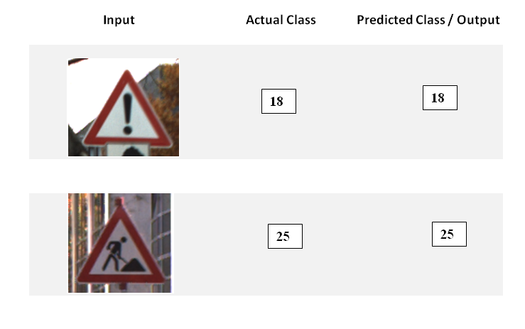
Results
Training Accuracy: 98.91%
Validation Accuracy: 94.03%
Testing Accuracy: 96.04%
Figure 5.1: Left side, middle and right side of all the four rows shown above are Input Image, Actual Class and Predicted Class or Output respectively.

Slide 9
Predictive Maintenance
Predictive maintenance is the practice of determining the condition of equipment in order to estimate when maintenance should be performed.
Problem Statement
Develop an efficient predictive model on Turbofan Engine Degradation Simulation dataset to predict that which engine will need maintenance after 30 days.

Slide 10
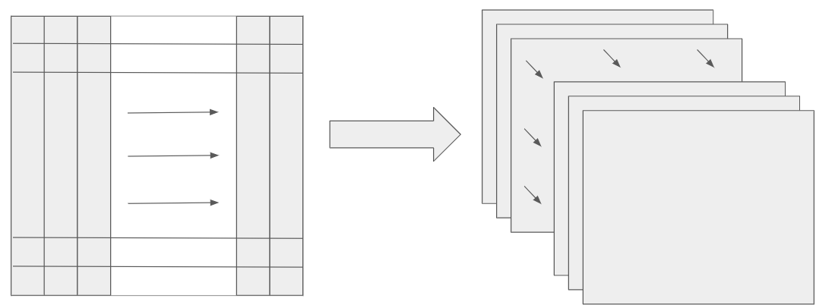
Proposed Solution
Data Reading
Loading the data from a source and place it into the volatile memory for processing.
Data Preparation
Converting the tabular form of data into set of frames by considering the window size which can be shown by Figure 1.1.
Window size is the number of rows taken from tabular form of data to make a frame.
Splitting the modified dataset into training, validation and testing set.
Window Size
Figure 1.1: Converting tabular data to set of frames

Slide 11
Model Creation
Developing CNN, LSTM, CNN - LSTM and Convolutional LSTM models which can be train and validate using training and validation dataset respectively.
Model Evaluation
Testing all the models by calculating the accuracy on testing dataset.
Model Prediction
Comparison of all the mentioned four models based on accuracy and size to select the best model for prediction on new data. Best model have high accuracy and less size.

Slide 12
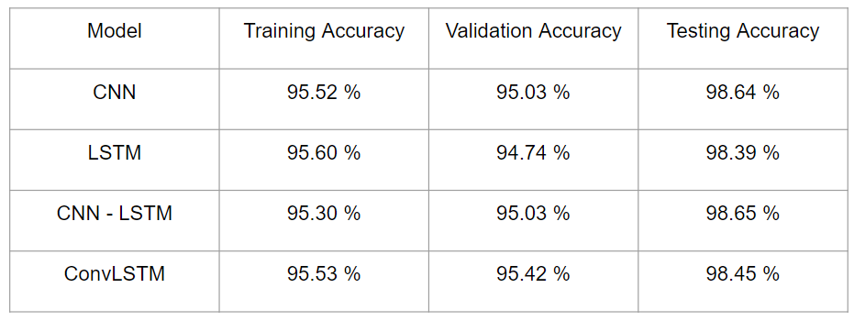
Results
Table 1.2: Table of Comparison for Models based on Accuracy
After analyzing Table 1.2, we can conclude that we cannot select the model based on accuracy only because all models are showing almost similar accuracy. So now we have to analyze models based on size to select the best model.

Slide 13
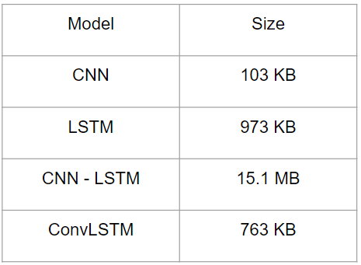
Table 1.3: Table of Comparison for Models based on Size
After analyzing Table 1.3, we can conclude that CNN model is the best model because it has less size.
After analyzing Table 1.2 and 1.3, we can conclude that CNN model is the best model because it has high accuracy as well as less size.

Slide 14
Voice Chatbot
Chatbot: A chatbot is artificial intelligence (AI) software that can simulate a
conversation (or a chat) with a user in natural language through messaging
applications, websites, and mobile apps or through the telephone.
Voice chatbot: It is similar to the chatbot only difference is that it takes voice
as input and also gives voice as output.
Chatbot Corpus: It is a corpus of dialog data that is included in the
chatterbot module.

Slide 15
Logic used to develop Voice Chatbot
Logic to build the Voice Chatbot mainly consists of three steps :
First we have to develop a chatbot which can take the text as input and gives
(reply) with text as output which can be used in step 2.
1. Converting the speech (user voice) into text
Recognize the voice of the user which is the input of the Voice Chatbot and convert the voice into string (text) for the next step.
2. Feed the text to chatbot which will give a reply to that text
3. Converting the reply into speech (chatbot voice)
Convert the text again to voice which is the output of the Voice Chatbot.
In python code I put these three steps in a infinite while loop and set a
condition that if user say “bye” then loop breaks and program terminates.

Slide 16
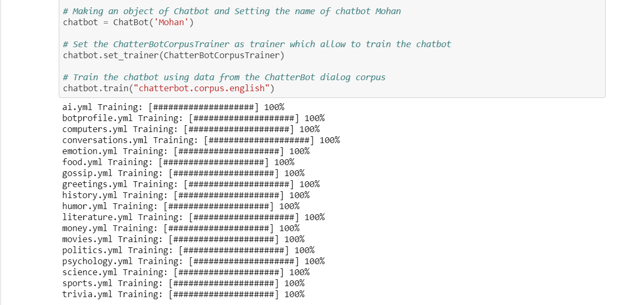
Implementation and Results
Importing necessary packages
Chatbot which can take the text and reply with text

Slide 17
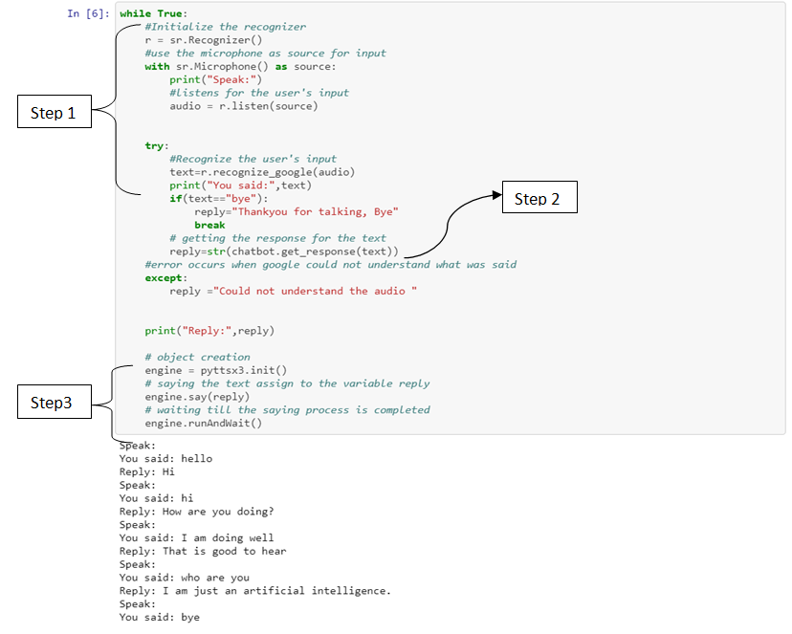
Voice Chatbot

Slide 18
Conclusion
During the Project Period from 13th January, 2020 to 25th June, 2020, I learned a lot in the field of Machine Leaning and Deep Learning. I learned something which I never learned before.
In this project, I have developed Convolutional Neural Network (CNN) model for Traffic Sign Recognition (TSR) to recognize the traffic sign images using German Traffic Sign Recognition Benchmark (GTSRB) Dataset.
After TSR, I have developed Convolutional Neural Network (CNN), Long Short Term Memory (LSTM), CNN - LSTM and Convolutional LSTM (ConvLSTM) models for Predictive Maintenance and selected the best model based on accuracy and size to predict that which engine will need maintenance after 30 days using Turbofan Engine Degradation Simulation Dataset.
I have also developed a simple Voice Chatbot which will take voice as input and give voice as output.
On visual inspection the results are found satisfactory.

Slide 19
Thank You

